Slide 1

US Healthcare Data Analysis: Patient Cost Optimization & Hospital Resource Management
Analysis By:
Ansari Fatma Begum Saifuddin
On 26th October 2024

Slide 2

To underststand the problem of analysing the impact of demographics & admission types on healthcare Costs & Outcomes.
I - Demographic Analysis of Medical Conditions based on Patient information
Objective: Identify the most prevalent medical conditions within different demographic groups*
Analysis: Analyze the frequency of each medical condition across different patient demographics. Bucket the demographics to make it presentable to high level management. Ensure not to create too many bucket and make the bucket mutually exclusive and collectively exhaustive.
Based on
Patient Information
Admission Information
Insurance Information

Slide 3

Key observation question tips
Demographic Analysis
Which medical condition is more prevalent?
Age group and Gender group wise
Gender wise most common medical condition
Which age group has more patients
Age group wise Most common medical condition
Blood group wise most common medical condition

Slide 4
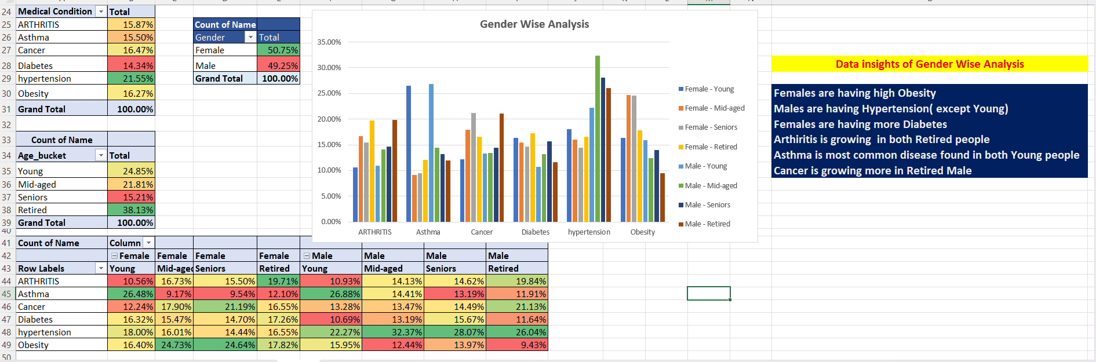
Gender wise analysis - insights

Slide 5
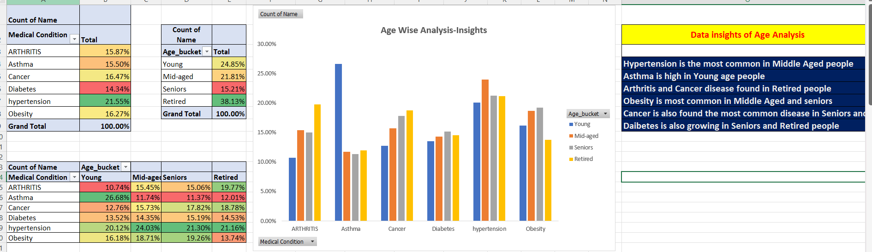
Age wise analysis - insights

Slide 6
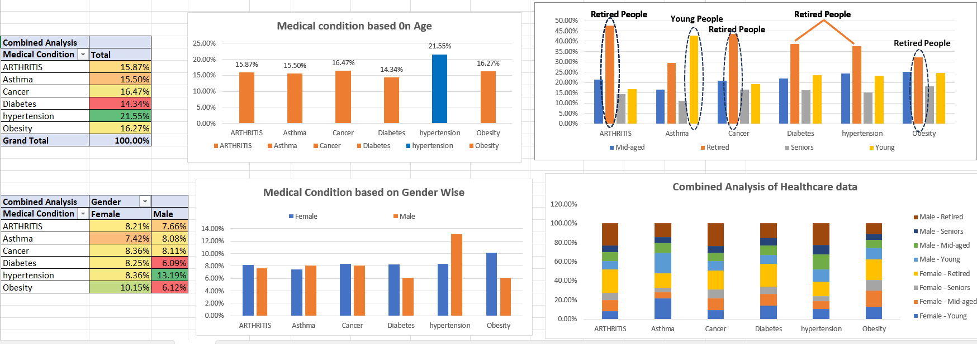
Medical condition based on age wise

Slide 7
Objective: Identify trends in the data and recommend ways for patients to reduce their cost.
Analysis: Calculate the average billing amount for different metrics. Determine if certain metrics consistently result in higher or lower healthcare costs. Try to relate it back to findings from the demographic analysis.
II - Patient Price Optimization based on Insurance Information

Slide 8

2 - Patient Cost Optimization
Medical condition wise expenses
Admission type wise costs
Number of days
Medication wise costs
Insurance provided wise costs
Test Results

Slide 9
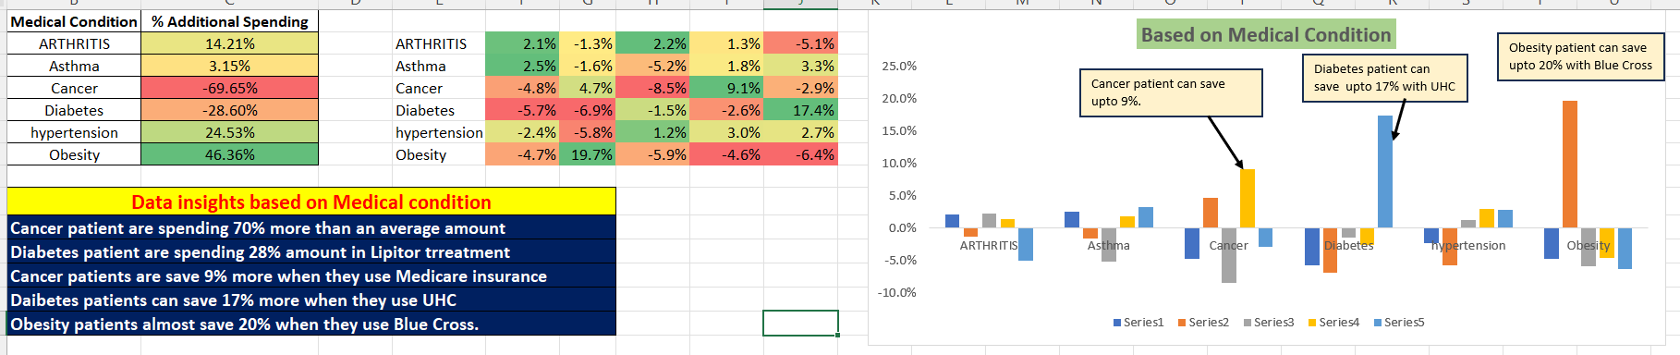
Data Insights based on medical condition

Slide 10
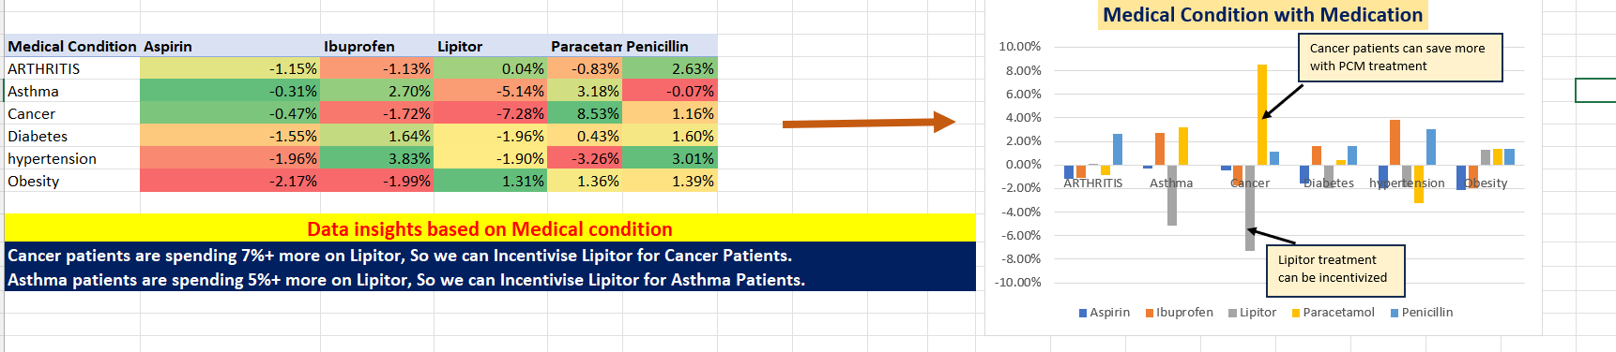
Data insights based on Medical Condition with medication

Slide 11
Objective: Objective: Identify ways in which hospital can better manage its resources.
Analysis: Identify time-series trends in admission type and suggest ways to improve the workload utilization of the hospital
III – Hospital Resource Management based on Admission Information

Slide 12

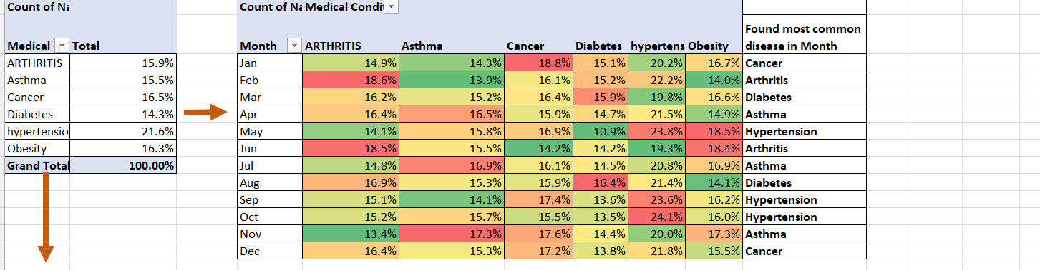
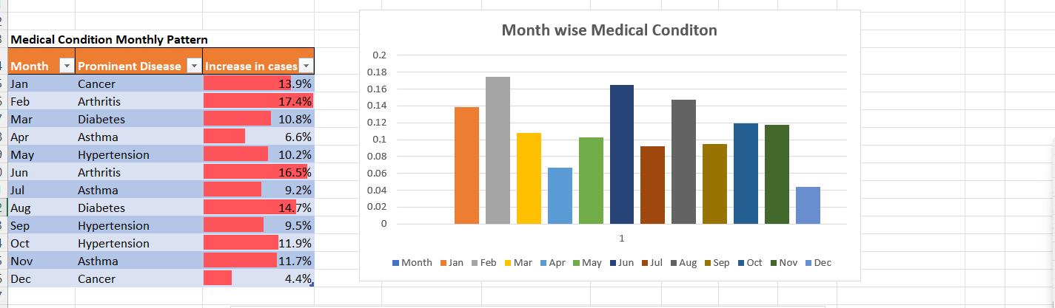
Month wise medical conditions

Slide 13
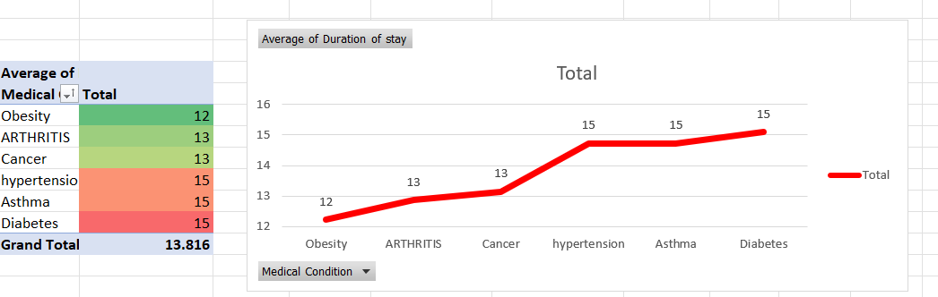
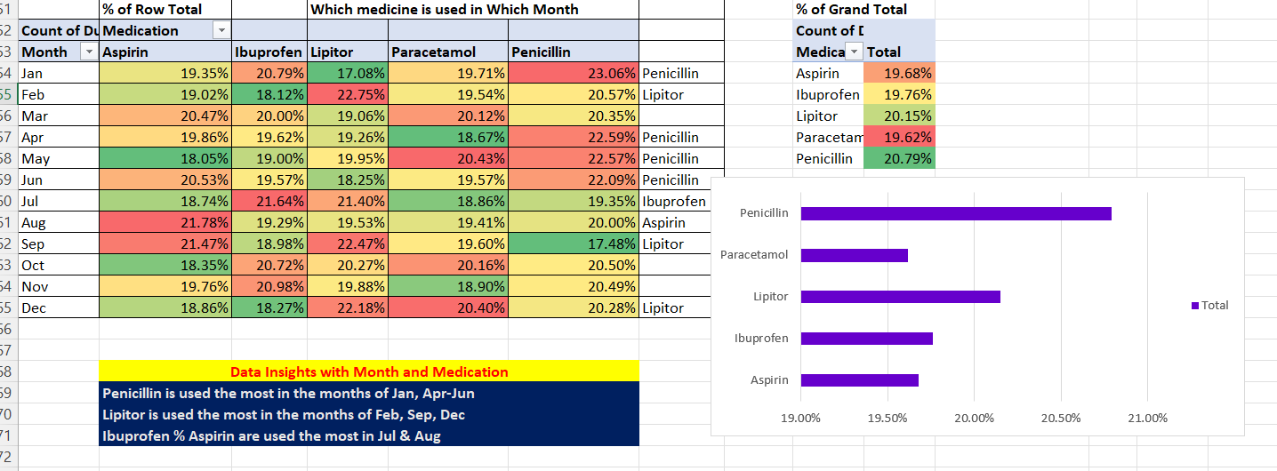
Month wise medical conditions

Slide 14
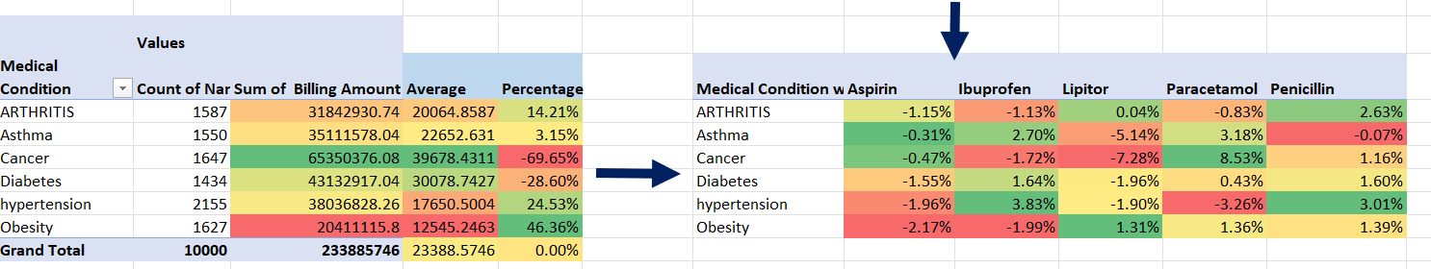
Final Data Insights
Data Insights Analysis
Cancer patient are spending 70% more than an average amount
Diabetes patient are spending 28% more than an average amount
With Aetna and Cigna patients are spending 3% more than
Blue Cross patients are spending 3% more than
Cancer patient lose 7.2% on Lipitor treatment
Asthma patient lose 5.14% on Lipitor patient

Slide 15

Thank You
Fatma Begum Saifuddin Ansari
fatmaansarisaif@gmail.com
www.linkedin.com/in/fatma-ansari-alif

